Slide 1
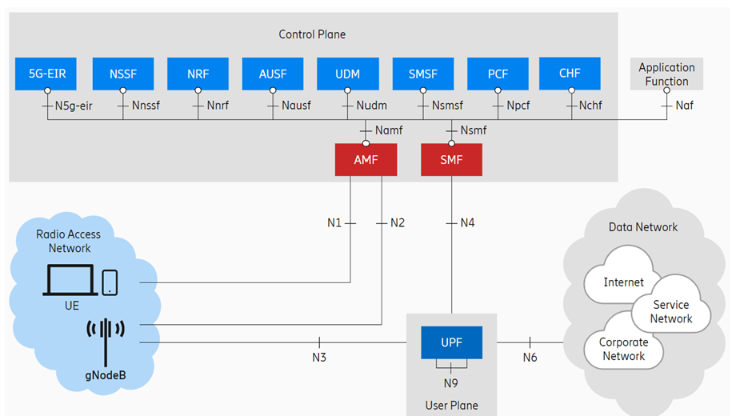
3GPP TS 22.104 Service requirements for cyber-physical control applications in vertical domains
Factories of the Future
The manufacturing industry is currently subject to a fundamental change, which is often referred to as the "Fourth Industrial Revolution" or simply "Industry 4.0" [15]. The main goals …
Mobile robots
Mobile robot systems are characterized by a maximum flexibility in mobility …
Customer Requirement:
CR1234: Our products must support
the function of Mobile Robots in vertical domains.
NFR1234 Regarding mobile robots,
as described in TS 22.104, V19.1.0 (2023-09),
chapter A.2.2.3, Use Case 1:
UPF shall take less than X ms (one way latency),
with Y% reliability.

